Slide 1
Newcomers Lunch

Slide 2
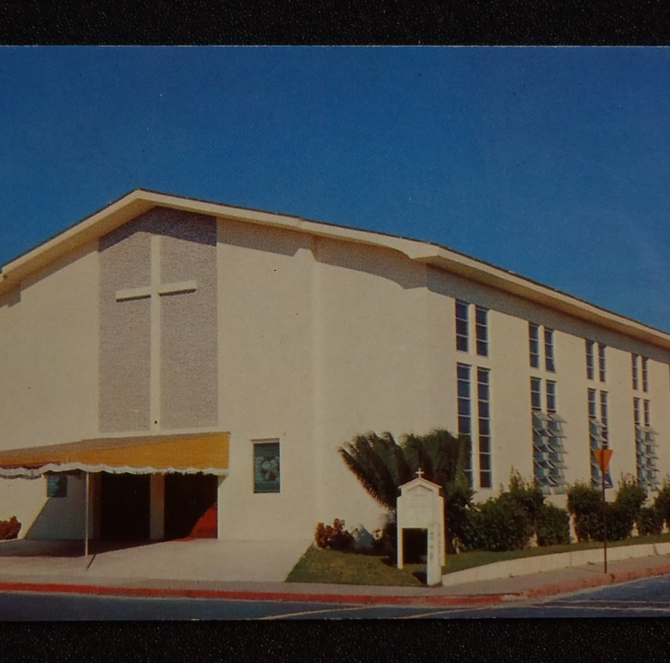
History
<name of church > started <Date> as a result of prayer and the dedication of people to begin a church in this area. Here are some early photos of our church.

Slide 3
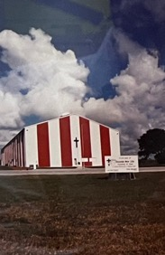
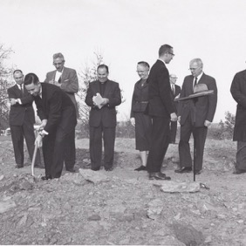
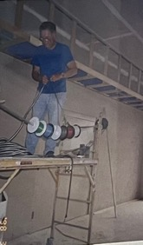
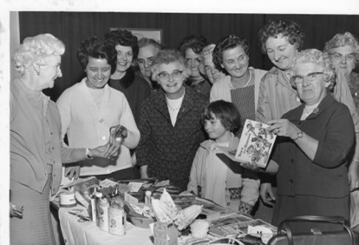
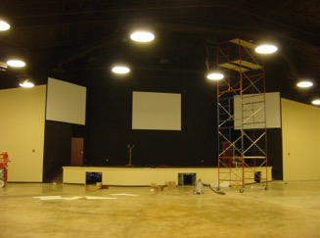
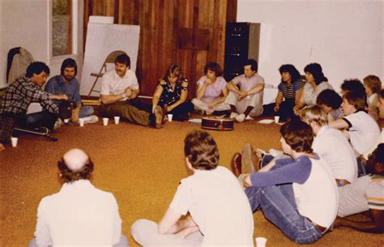
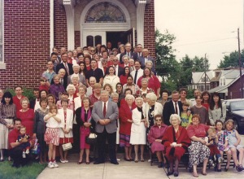

Slide 4
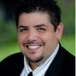
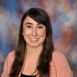
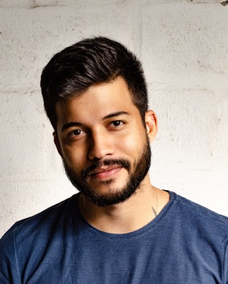
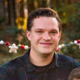
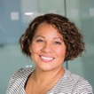
OUR STAFF

Slide 5
We are part of a larger family of 1000 churches across Canada with a rich history.

Slide 6
Our Mission: We're here to help people Know God, Find Freedom, Discover their Purpose, Make a Difference

Slide 7
Our 10 Year Vision: To see our church plant three other churches within a 100 km radius

Slide 8
Getting Involved

Slide 9
Sundays
Our goal is for the whole family to experience the presence of God and grow in faith through worship, teaching, and fellowship.

Slide 10
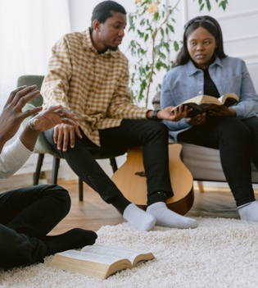
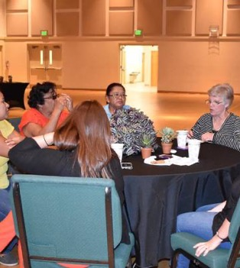
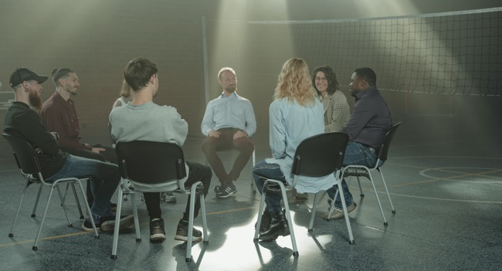
Groups
Classes: Baptism, Alpha, New Believers Class,
Community Groups: Young Families, Men, Women, Young Adults, Youth, Kids
Small Groups: In homes, at the church, list
Interest Groups: golf, sewing, fishing, gardening

Slide 11
Ministries
Children’s Ministry
Youth Ministry
Worship & The Arts
Community Outreach Ministry

Slide 12
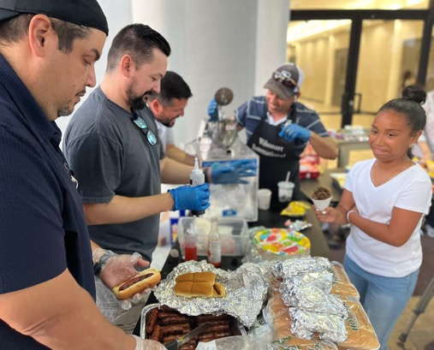
Serve Teams
Kids Ministry Team
Youth Ministry Team
Sundays (Greeter, Ushers, Hospitality)
Creative Team (worship, tech, video)
Special Events Team
Building (setup/teardown, repair)

Slide 13
How To Become a Member?
I am a dedicated follower of Jesus
I am committed to the vision and mission of this church
I have been faithfully attending for six months
I will fill out the application and interview with a board member

Slide 14
Next Steps?
1. Join a Group: Start with Alpha
2. Volunteer: Fill a Volunteer Application
3. Membership: Fill a Membership Application

Slide 15
Thank You For Being Here

